Slide 1
Semantic Computing
Introduction

Slide 2
Agenda of the Day
Introduction to Semantic Computing
Web
  Today’s Web
  Semantic Web
Paradigm Shift
  Today’s Web to Semantic Web
Semantic Web Technologies
A Layered Approach

Slide 3
Semantic Computing?
Computing with the “meanings”
Try to extract the implicit relation and meanings
Interpret large volumes of data by machines instead of humans (hopefully in an intelligent way)
WWW is an example of Large volumes of data
“Google’s mission is to organize the world‘s information and make it universally accessible and useful”

Slide 4
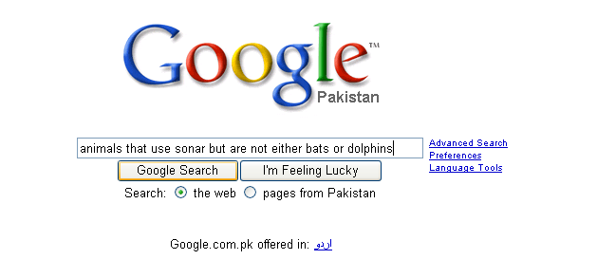

Slide 5
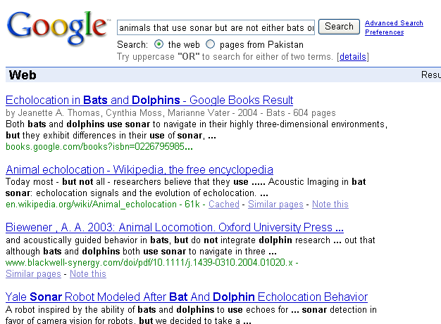
First results are about bats and dolphins

Slide 6
Why?
Web content is currently formatted for human readers rather than programs
HTML is the predominant language in which Web pages are written (directly or using tools)
Vocabulary describes presentation

Slide 7
HTML?
<HTML><BODY>
<H2 align=center>Nonmonotonic Reasoning: Context- Dependent Reasoning</H2>
<P align=center>
<I>by<B>V. Marek</B>
and <B>M Truszczynski</B></I>
<BR>Springer 1993
<BR>ISBN 0387976892
</P>
</BODY></HTML>

Slide 8
HTML?
Inability to cover any content aspects – HTML only describes the appearances of documents and cannot cover any content related aspects. It is therefore unsuitable for explicit queries.
Inability for semantic markup – Individual elements on a page cannot be marked semantically.

Slide 9
Why does this happen??
The Web content is not machine-accessible
  lack of semantics
  Not in a proper structure
  Not in a machine understandable manner
keyword-based search engines
  (e.g. Google, AltaVista, Yahoo)

Slide 10
How to overcome these limitations
Currents situation can be improved by adopting following two strategies
  Use the content as it is represented today, and to develop techniques based on artificial intelligence and computational linguistics.
    This approach has been followed for sometime now, but despite advances that have been made the task still appears too ambitious.
Represent Web content in a form that is more easily machine processable
  Then use intelligent techniques to take advantage of these representations (Semantic Web).

Slide 11
What should we do?
Simple lesson learnt from Basic Computer Science
  Provide a structure to content

Slide 12
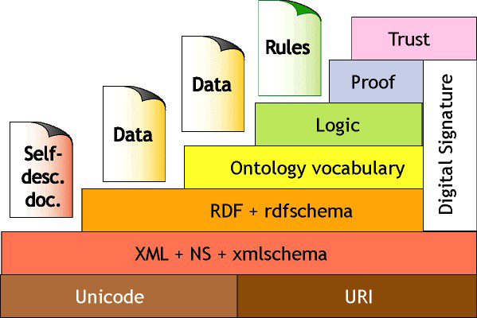
Semantic Web
A Layered Approach

Slide 13
Semantic Computing
Understanding the (possibly naturally expressed) intentions (semantics) of user and expressing them in a machine processable language
Semantic Computing addresses technologies that facilitate the derivation of semantics from content and connecting semantics into knowledge,
  “content” may be anything such as video, audio, text, conversation, process, program, device, behavior, etc.

Slide 14
Applications
Semantic Computing encompasses all aspects of computing where data is encoded, processed, stored or transferred using techniques that communicate the meaning of the data in addition to the data itself.
  Search engines and question answering
  Semantic web services
  Content-based multimedia retrieval and editing
  Context-aware networks of sensors, devices and applications
  Machine translation
  Creative art description
  Medicine and biology
  Semantic programming languages and software engineering
  System design and synthesis

Slide 15
Read Chapter 1 of
Semantic Web Primer and Tim Berner Lee Paper
The Semantic Web

Slide 16
THANKS
Question & Answers

